Slide 1

Las Vegas
Group #1
Photo by Sasha • Instagram.com/sanfrancisco on Unsplash
Photograph is public domain. License info:
All photos published on Unsplash are licensed under Creative Commons Zero and Unsplash License which means you can copy, modify, distribute and use the photos for free, including commercial purposes, without asking permission from or providing attribution to the photographer or Unsplash.
CREATIVE COMMONS ZERO: http://creativecommons.org/publicdomain/zero/1.0/

Slide 2







Notes:
From left to right
Row 1: Manuel Andrade, Jubin Taghir, Yibo Wang, Amanda Liu
Row 2: Richard Cummings, Madison Trejo, Fahim Zahir

Slide 3
Summary/ Agenda
Introduction
1
2
Data Cleaning & Pre-Processing
Data Mining Tasks
3
4
KNN
Logistic Regression
5
6
CART
MLR
7
8
Best Model/ Conclusion
Notes:
Introduction: Madison
Data Cleaning & Preprocessing: Manny
Data Mining Tasks: Manny
KNN: Manuel/Jubin
Logistic Regression: Amanda
CART: Ricky
Multiple Linear Regression: Fahim
Best Model: Fahim/Yibo
Conclusion: Yibo

Slide 4
Introduction to Dataset
Dataset: Hotel Las Vegas, Tripadvisor
19 possible predictors, 1 outcome variable
Models and algorithms:
KNN for both prediction and categorical
LOGIT for both prediction and categorical
MLR (continuous outcome)
CART.
Are there significant variables that can indicate hotel score?
Outcome: Bad Results
Notes:
Our group conducted a data mining analysis where we attempted to predict the hotel score on Tripadvisor for hotels in Las Vegas. For those of you who are not familiar, Tripadvisor is a site that has hotel scores. Our data is based on Tripadvisor reviews. The data pertains to a sample of Las Vegas hotels on Tripadvisor. The dataset initially had 504 records with 20 variables. Of these variables, 19 may be used as predictors, and 1 may be used as an outcome variable, which was the score. However, not all 19 predictors are appropriate to use. We will discuss the reason for this in the preprocessing data section. The dependent variables have scores from 1-5 and all are integers.
The goal was to predict the outcome. We took various approaches and ran the outcome variable, score, as categorical and continuous. This was to ensure that we explored and developed the best possible model to try to predict the outcome most accurately.
This leads us to run models and algorithms for both continuous outcomes and categorical outcomes. The models and algorithms we used were K-nearest number for both prediction and categorical, logistic regression for both prediction and categorical, MLR (continuous outcome), and CART.
However, the results we retrieved from the models and algorithms had poor results when predicting the outcome variable. This leads us to select the best model or algorithm based on the results generated. Even though the model had poor results, it was still the best one. We will describe the model results later on.

Slide 5
Introduction
Related Papers
An Examination of Online Ratings on Hotel Performance Indicators: An Analysis Of The Boston Hotel Market
Understanding the Impact Of Online Reviews on Hotel Performance: An Empirical Analysis
Inside the Rating Scores: A Multilevel Analysis of the Factors Influencing Customer Satisfaction in the Hotel Industry
Notes:
We were able to compare our analysis to those from three other papers taken from various journals.
First, a paper from Iowa State University used data mining to predict the Average Daily Rate of a hotel. They did this using the variables value, location, sleep, staff, room, cleanliness and overall score all obtained from Tripadvisor, which was our data source. Our data was similar because we both used score as a key variable. They evaluated their variables using the methods including descriptive statistics, ANOVA, and multiple regression.
Another source was from the Journal of Travel Research, which examined which factors affect online hotel reviews and used hotel occupancy as a performance metric. They did this using the variables: physical aspects; quality of food and drink; and human
aspects of service provision. They evaluated their variables using linear regression and logistic regression.
A paper from Cornell Hospitality Quarterly examines factors affecting customer satisfaction and their ratings in the hotel industry. It examines the variables service encounter, visitor, visitor’s nationality, hotel, and destination by integrating multiple levels of analysis into a single statistical model. They used data mining techniques including least squares regression.
Yibo will discuss how the results from these three papers differed from ours in the conclusion.

Slide 6
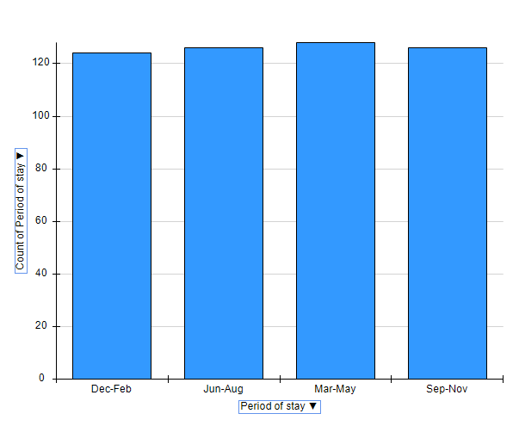
Data Cleaning & Data Preprocessing
Reference Only: User country, Nr. Reviews, Nr. hotel reviews, Helpful votes, Period of stay, Traveler type, Pool, Gym, Tennis court, Spa, Casino, Free internet, Hotel name, Hotel stars, Nr. Rooms, User continent, Member years, Review month, Review weekday
Two eliminations: Hotel Name and Helpful Votes
Period of Stay vs. Review Month
Notes:
First, we originally had 19 predictors(may be seen above for reference) and 1 outcome variable with 504 records. However, right away, we noted a couple of variables that did not help predict the outcome variable. Specifically, we discarded Hotel Name and then proceeded to toss helpful votes since it is unclear what the helpful votes were for. Even the contributor of the data did not specify the intention (reference here). We decided to delete the review month as the “Period of stay” was more suited. This is because using the period of stay as quarters was more convenient since we may label Dec. – Feb. as 1, Jun- Aug = 2, Mar – May = 3, and Sep- Nov = 4. Thus, we reduced the categories and made them dummy variables. Also, based on the bar chart, the frequencies were even. Therefore, we will have fewer dummy variables and make better sense of the data overall. A similar explanation goes into transforming weekday reviews.

Slide 7
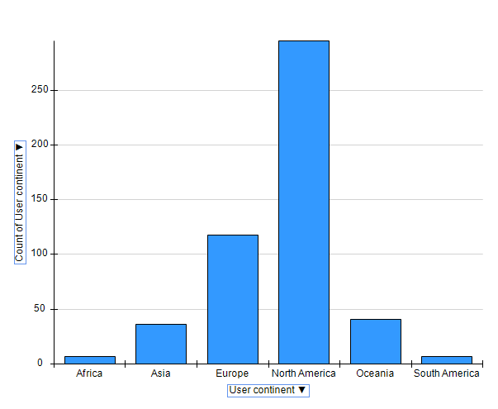
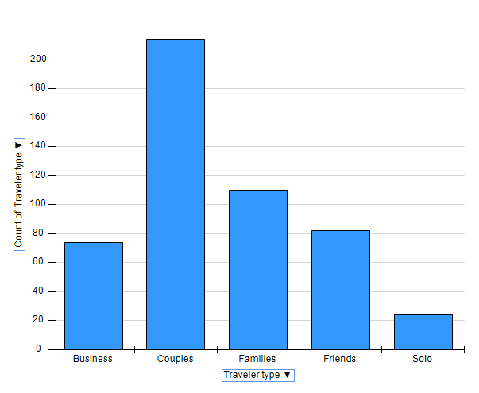
Data Cleaning & Data Preprocessing
User Country Vs User Continent
Traveler Type
Notes:
Similarly, we decided to User Continent instead of User Country as there were too many countries. Also, we would have more even frequencies for the contents after we combined some of them. Therefore, we combined all continents except for Europe and North America, as Other Continent. We then proceeded to make dummy variables out of these continents. Likewise, we combined categories for “traveler type” because of uneven frequencies. Thus, we combine all traveler types, except for families and couples, into others.
Aside from this, we proceeded to look at outliers for continuous variables and deleted predictors because of highly uneven frequencies for categorical data.

Slide 8
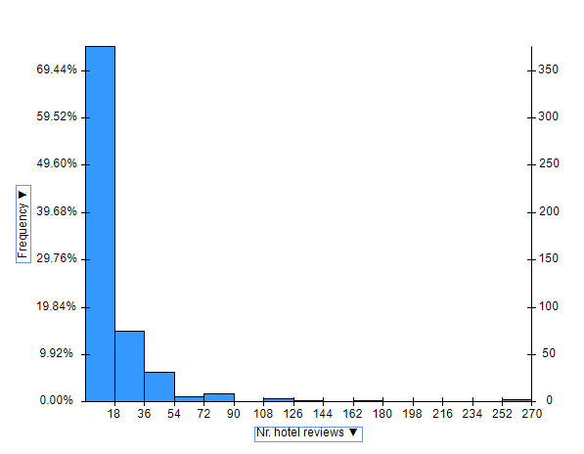
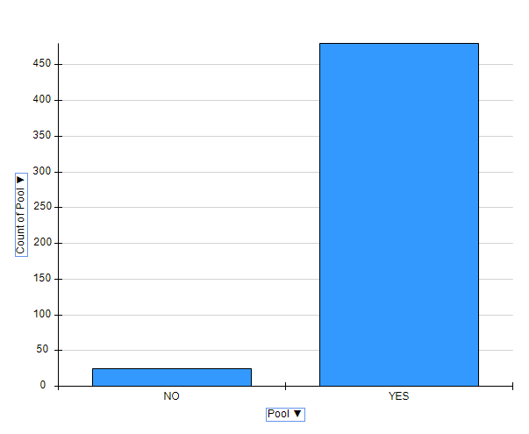
Data Cleaning & Data Preprocessing
Nr Hotel Reviews
Nr. Reviews
Categorical Predictors: Pool, Internet, Gym, Spa, and others
Notes:
Specifically, we deleted outliers for predictors Nr. Hotel reviews, and Nr.Reviews. For instance, referencing the graph for Nr. Hotel reviews, we deleted all records that contain values over 90. In similar fashion we deleted records with outliers for Nr. Reviews, referencing the graph for Nr. Reviews.
Most importantly, we were forced to delete the following categorical predictors: Pool, Internet, Gym, Spa, and others due to few frequencies. For instance, only pool had, referencing the data and bar chart, 24 hotels that said “No” pool. Thus, they had over 450 responses of “Yes”. An extremely similar applies to internet, gym, and spa.

Slide 9
Data Mining Tasks
Nr. Reviews: number of reviews the hotel had
Nr. hotel reviews: number of reviews the hotel had for its hotels specifically
Nr. Rooms: number of rooms a hotel has
Member years: the number of years a member has been on TripAdvisor
Period of stay: period or quarter traveler stayed
Traveler type: was traveler other, family, couple
Tennis court: does the hotel have a tennis court? Yes = 1/no = 0
Hotel stars: what was the hotel star rating, 1, 1.5 , 2, 2.5, etc up to 5
User continent: was traveler from North America, Europe, Other continent
Review weekday: day of the week the review was written.
Which predictor helps us best predict the outcome?
Notes:
Thus, after preprocessing the data we were left with only 10 predictors, which were of interest in aiding to predict the outcome. Furthermore, to ensure there is no collinearity between the data we will conduct a collinearity check.

Slide 10
Data Cleaning & Data Preprocessing: Collinearity Check (Categorical)
Categorical
 | Nr. reviews | Nr. hotel reviews | Helpful votes | Score | Nr. rooms | Member years | Period of stay_Dec-Feb | Period of stay_Jun-Aug | Period of stay_Mar-May | Period of stay_Sep-Nov | Traveler type Other | Traveler type Families | Traveler type Couples | Tennis court_YES | Hotel stars 3 and 3.5 | Hotel stars 4 and 4.5 | Hotel stars 5 | User continent Other | User continent Europe | User continent North America | Review weekday_Friday | Review weekday_Monday | Review weekday_Saturday | Review weekday_Sunday | Review weekday_Thursday | Review weekday_Tuesday | Review weekday_Wednesday
Nr. reviews | 1
Nr. hotel reviews | 0.711316 | 1
Helpful votes | 0.695944 | 0.672586 | 1
Score | -0.04865 | -0.02983 | -0.01291 | 1
Nr. rooms | -0.08497 | -0.09453 | -0.01674 | -0.08515 | 1
Member years | 0.129817 | 0.288697 | 0.290652 | 0.020534 | 0.00624 | 1
Period of stay_Dec-Feb | 0.020022 | 0.018156 | 0.042714 | 0.037131 | -0.01854 | 0.07472 | 1
Period of stay_Jun-Aug | -0.00579 | 0.01945 | -0.04018 | -0.01519 | 0.005546 | -0.00447 | -0.31811 | 1
Period of stay_Mar-May | 0.004563 | -0.00559 | 0.048825 | -0.0612 | 0.012538 | 0.02687 | -0.32906 | -0.34284 | 1
Period of stay_Sep-Nov | -0.01829 | -0.03128 | -0.05084 | 0.040712 | -0.00014 | -0.09519 | -0.32358 | -0.33713 | -0.34875 | 1
Traveler type Other | 0.062321 | 0.020885 | 0.046502 | -0.08863 | -0.00869 | -0.04406 | 0.009284 | -0.0372 | 0.044281 | -0.01676 | 1
Traveler type Families | 0.007521 | 0.038567 | -0.01489 | -0.01024 | -0.06424 | 0.030887 | 0.002491 | 0.101979 | -0.04368 | -0.0595 | -0.39799 | 1
Traveler type Couples | -0.06655 | -0.05289 | -0.03226 | 0.094255 | 0.062907 | 0.016327 | -0.01108 | -0.05062 | -0.00568 | 0.066676 | -0.62767 | -0.46436 | 1
Tennis court_YES | -0.06075 | -0.05882 | -0.08646 | 0.005653 | -0.21995 | -0.01056 | -0.02444 | -0.0075 | 0.023063 | 0.007909 | 0.059624 | -0.07716 | 0.007913 | 1
Hotel stars 3 and 3.5 | 0.031745 | 0.016745 | -0.04312 | -0.08917 | -0.3019 | 0.003549 | -0.02179 | 0.007019 | 0.017459 | -0.00341 | 0.001273 | 0.119385 | -0.10254 | 0.061171 | 1
Hotel stars 4 and 4.5 | -0.01821 | -0.05177 | -0.05208 | -0.17738 | -0.15491 | -0.1102 | -0.0133 | -0.00124 | 0.002482 | 0.011636 | 0.008827 | -0.1069 | 0.082192 | 0.16398 | -0.43467 | 1
Hotel stars 5 | -0.01389 | 0.031306 | 0.089252 | 0.248412 | 0.432721 | 0.097544 | 0.033169 | -0.00563 | -0.01909 | -0.00737 | -0.00931 | -0.01705 | 0.02346 | -0.20916 | -0.56496 | -0.49752 | 1
User continent Other | -0.05975 | 0.028599 | -0.05592 | -0.09475 | 0.026013 | -0.06455 | -0.07721 | 0.023662 | -0.0032 | 0.054719 | -0.03183 | 0.10161 | -0.0555 | 0.085652 | -0.00106 | 0.018256 | -0.0157 | 1
User continent Europe | -0.02611 | 0.044311 | 0.009132 | -0.02287 | 0.153 | 0.033259 | -0.09477 | 0.027601 | -0.03507 | 0.09998 | -0.01929 | -0.05106 | 0.061952 | 0.006143 | -0.06086 | -0.01945 | 0.076437 | -0.26412 | 1
User continent North America | 0.069271 | -0.06061 | 0.035864 | 0.093852 | -0.15237 | 0.021793 | 0.14218 | -0.04233 | 0.032763 | -0.12908 | 0.041546 | -0.03543 | -0.01005 | -0.07231 | 0.053346 | 0.002502 | -0.05368 | -0.55437 | -0.6563 | 1
Review weekday_Friday | -0.04492 | 0.002435 | 0.001522 | 0.037155 | 0.149017 | 0.007909 | -0.02242 | -0.03556 | 0.097278 | -0.04104 | -0.07534 | 0.058739 | 0.022891 | -0.01857 | -0.03344 | -0.0023 | 0.034317 | 0.027667 | 0.01827 | -0.03741 | 1
Review weekday_Monday | -0.04521 | -0.11704 | -0.01958 | -0.02478 | -0.03191 | -0.01548 | -0.08792 | 0.00099 | 0.031832 | 0.052279 | -0.01812 | -0.09753 | 0.100259 | 0.048987 | -0.04175 | 0.003947 | 0.0366 | -0.01088 | -0.04749 | 0.049487 | -0.15631 | 1
Review weekday_Saturday | 0.062361 | 0.06687 | 0.058922 | 0.028828 | 0.127205 | 0.018892 | 0.041269 | 0.012287 | -0.10314 | 0.051729 | 0.000855 | -0.01509 | 0.011978 | 0.014202 | 0.002271 | -0.02604 | 0.021671 | 0.078065 | 0.037249 | -0.09321 | -0.14624 | -0.14895 | 1
Review weekday_Sunday | 0.054621 | 0.064572 | 0.022547 | 0.039203 | -0.08747 | -0.00698 | -0.04172 | 0.071316 | -0.08023 | 0.050673 | -0.0355 | 0.065719 | -0.02149 | 0.020035 | -0.0061 | -0.0112 | 0.016133 | -0.00635 | 0.011452 | -0.00491 | -0.16193 | -0.16493 | -0.15431 | 1
Review weekday_Thursday | 0.010144 | 0.020134 | -0.01493 | -0.00215 | -0.05304 | 0.010795 | 0.075158 | -0.02868 | -0.0249 | -0.01942 | 0.053912 | 0.035947 | -0.08255 | 0.018634 | 0.043201 | -0.00873 | -0.03362 | 0.034108 | 0.040733 | -0.06183 | -0.1506 | -0.15339 | -0.14351 | -0.1589 | 1
Review weekday_Tuesday | 0.009619 | -0.04472 | 0.004825 | -0.07969 | -0.03676 | 0.048883 | 0.0954 | -0.10914 | 0.089916 | -0.07504 | 0.049269 | -0.04845 | -0.00645 | 0.018131 | 0.006801 | 0.00884 | -0.01465 | -0.07548 | -0.07245 | 0.121567 | -0.17429 | -0.17752 | -0.16609 | -0.1839 | -0.17103 | 1
Review weekday_Wednesday | -0.04251 | 0.012369 | -0.04777 | 0.00788 | -0.05091 | -0.06122 | -0.05764 | 0.087524 | -0.01858 | -0.01211 | 0.020692 | 0.003531 | -0.02297 | -0.09444 | 0.027168 | 0.030933 | -0.05451 | -0.03316 | 0.01917 | 0.009395 | -0.17565 | -0.1789 | -0.16738 | -0.18533 | -0.17236 | -0.19948 | 1
Notes:
First, we will start with categorical output to ensure that everything is consistent. Although hard to tell from the low image quality, after running a collinearity check, although hard to tell 2 values in absolute stand out. These values are, which are in absolute value, 0.711 between Nr. Reviews and Nr. Hotel Reviews, and 0.6563 between User Continent Europe and User Content North America. This is normal as there may be a correlation between the Nr. Reviews and Nr. Hotel REview. However, one is not indicative of the other. A similar logic applies between User Continent Europe and User Content America. Moreover, the absolute value for both correlations is less than 0.8.

Slide 11
Data Cleaning & Data Preprocessing: Collinearity Check
Continuous
 | Nr. reviews | Nr. hotel reviews | Helpful votes | Score | Nr. rooms | Member years | Period of stay_Dec-Feb | Period of stay_Jun-Aug | Period of stay_Mar-May | Period of stay_Sep-Nov | Traveler type Other | Traveler type Families | Traveler type Couples | Tennis court_YES | Hotel stars 3 and 3.5 | Hotel stars 4 and 4.5 | Hotel stars 5 | User continent Other | User continent Europe | User continent North America | Review weekday_Friday | Review weekday_Monday | Review weekday_Saturday | Review weekday_Sunday | Review weekday_Thursday | Review weekday_Tuesday | Review weekday_Wednesday
Nr. reviews | 1
Nr. hotel reviews | 0.711316 | 1
Helpful votes | 0.695944 | 0.672586 | 1
Score | 0.049671 | 0.020698 | 0.032505 | 1
Nr. rooms | -0.08497 | -0.09453 | -0.01674 | -0.07736 | 1
Member years | 0.129817 | 0.288697 | 0.290652 | 0.051771 | 0.00624 | 1
Period of stay_Dec-Feb | 0.020022 | 0.018156 | 0.042714 | 0.042662 | -0.01854 | 0.07472 | 1
Period of stay_Jun-Aug | -0.00579 | 0.01945 | -0.04018 | 0.013627 | 0.005546 | -0.00447 | -0.31811 | 1
Period of stay_Mar-May | 0.004563 | -0.00559 | 0.048825 | -0.04238 | 0.012538 | 0.02687 | -0.32906 | -0.34284 | 1
Period of stay_Sep-Nov | -0.01829 | -0.03128 | -0.05084 | -0.0122 | -0.00014 | -0.09519 | -0.32358 | -0.33713 | -0.34875 | 1
Traveler type Other | 0.062321 | 0.020885 | 0.046502 | -0.05519 | -0.00869 | -0.04406 | 0.009284 | -0.0372 | 0.044281 | -0.01676 | 1
Traveler type Families | 0.007521 | 0.038567 | -0.01489 | -0.05536 | -0.06424 | 0.030887 | 0.002491 | 0.101979 | -0.04368 | -0.0595 | -0.39799 | 1
Traveler type Couples | -0.06655 | -0.05289 | -0.03226 | 0.100263 | 0.062907 | 0.016327 | -0.01108 | -0.05062 | -0.00568 | 0.066676 | -0.62767 | -0.46436 | 1
Tennis court_YES | -0.06075 | -0.05882 | -0.08646 | 0.044074 | -0.21995 | -0.01056 | -0.02444 | -0.0075 | 0.023063 | 0.007909 | 0.059624 | -0.07716 | 0.007913 | 1
Hotel stars 3 and 3.5 | 0.031745 | 0.016745 | -0.04312 | -0.08709 | -0.3019 | 0.003549 | -0.02179 | 0.007019 | 0.017459 | -0.00341 | 0.001273 | 0.119385 | -0.10254 | 0.061171 | 1
Hotel stars 4 and 4.5 | -0.01821 | -0.05177 | -0.05208 | -0.13452 | -0.15491 | -0.1102 | -0.0133 | -0.00124 | 0.002482 | 0.011636 | 0.008827 | -0.1069 | 0.082192 | 0.16398 | -0.43467 | 1
Hotel stars 5 | -0.01389 | 0.031306 | 0.089252 | 0.207133 | 0.432721 | 0.097544 | 0.033169 | -0.00563 | -0.01909 | -0.00737 | -0.00931 | -0.01705 | 0.02346 | -0.20916 | -0.56496 | -0.49752 | 1
User continent Other | -0.05975 | 0.028599 | -0.05592 | -0.06342 | 0.026013 | -0.06455 | -0.07721 | 0.023662 | -0.0032 | 0.054719 | -0.03183 | 0.10161 | -0.0555 | 0.085652 | -0.00106 | 0.018256 | -0.0157 | 1
User continent Europe | -0.02611 | 0.044311 | 0.009132 | 0.011706 | 0.153 | 0.033259 | -0.09477 | 0.027601 | -0.03507 | 0.09998 | -0.01929 | -0.05106 | 0.061952 | 0.006143 | -0.06086 | -0.01945 | 0.076437 | -0.26412 | 1
User continent North America | 0.069271 | -0.06061 | 0.035864 | 0.039512 | -0.15237 | 0.021793 | 0.14218 | -0.04233 | 0.032763 | -0.12908 | 0.041546 | -0.03543 | -0.01005 | -0.07231 | 0.053346 | 0.002502 | -0.05368 | -0.55437 | -0.6563 | 1
Review weekday_Friday | -0.04492 | 0.002435 | 0.001522 | 0.042948 | 0.149017 | 0.007909 | -0.02242 | -0.03556 | 0.097278 | -0.04104 | -0.07534 | 0.058739 | 0.022891 | -0.01857 | -0.03344 | -0.0023 | 0.034317 | 0.027667 | 0.01827 | -0.03741 | 1
Review weekday_Monday | -0.04521 | -0.11704 | -0.01958 | -0.0017 | -0.03191 | -0.01548 | -0.08792 | 0.00099 | 0.031832 | 0.052279 | -0.01812 | -0.09753 | 0.100259 | 0.048987 | -0.04175 | 0.003947 | 0.0366 | -0.01088 | -0.04749 | 0.049487 | -0.15631 | 1
Review weekday_Saturday | 0.062361 | 0.06687 | 0.058922 | 0.086602 | 0.127205 | 0.018892 | 0.041269 | 0.012287 | -0.10314 | 0.051729 | 0.000855 | -0.01509 | 0.011978 | 0.014202 | 0.002271 | -0.02604 | 0.021671 | 0.078065 | 0.037249 | -0.09321 | -0.14624 | -0.14895 | 1
Review weekday_Sunday | 0.054621 | 0.064572 | 0.022547 | 0.007529 | -0.08747 | -0.00698 | -0.04172 | 0.071316 | -0.08023 | 0.050673 | -0.0355 | 0.065719 | -0.02149 | 0.020035 | -0.0061 | -0.0112 | 0.016133 | -0.00635 | 0.011452 | -0.00491 | -0.16193 | -0.16493 | -0.15431 | 1
Review weekday_Thursday | 0.010144 | 0.020134 | -0.01493 | 0.00737 | -0.05304 | 0.010795 | 0.075158 | -0.02868 | -0.0249 | -0.01942 | 0.053912 | 0.035947 | -0.08255 | 0.018634 | 0.043201 | -0.00873 | -0.03362 | 0.034108 | 0.040733 | -0.06183 | -0.1506 | -0.15339 | -0.14351 | -0.1589 | 1
Review weekday_Tuesday | 0.009619 | -0.04472 | 0.004825 | -0.06646 | -0.03676 | 0.048883 | 0.0954 | -0.10914 | 0.089916 | -0.07504 | 0.049269 | -0.04845 | -0.00645 | 0.018131 | 0.006801 | 0.00884 | -0.01465 | -0.07548 | -0.07245 | 0.121567 | -0.17429 | -0.17752 | -0.16609 | -0.1839 | -0.17103 | 1
Review weekday_Wednesday | -0.04251 | 0.012369 | -0.04777 | -0.06113 | -0.05091 | -0.06122 | -0.05764 | 0.087524 | -0.01858 | -0.01211 | 0.020692 | 0.003531 | -0.02297 | -0.09444 | 0.027168 | 0.030933 | -0.05451 | -0.03316 | 0.01917 | 0.009395 | -0.17565 | -0.1789 | -0.16738 | -0.18533 | -0.17236 | -0.19948 | 1
Notes:
Fortunately, the same may be said about running having the output as conitnous.
This leads us to discuss our models and algorithms and see as to which variables were better. Also, we will attempt to explain why this data set is not that good after explaining the models and algorithms. Nonetheless, we must note that we used and 80/20 split to partition the data.

Slide 12
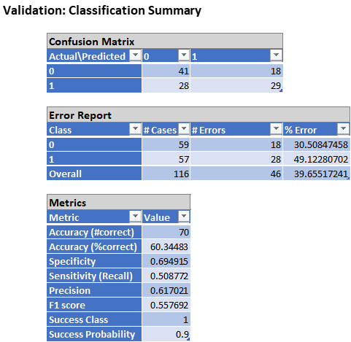
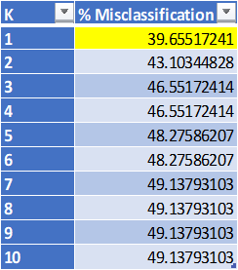
KNN Categorical
Cutoff: 0.90
Search Log
Notes:
KNN is a model free algorithm, and here we will be using it for categorical. In this case we found the best cutoff was 0.9 with a K=1.
First, we may note that the algorithm predicted 18 actual 0s, scores 4 and lower, as being 1 (a score of 5). This is somewhat high, compared to 1, as the number of times 0 was predicted to be 0 was 41.
By contrast, we may note that the times 1 was predicted as being 0 was 28 times. This is quite high. Also, when it comes to 1 actually being predicted as 1 we may count 29 times. This is higher than 0.
Thus, it is no surprise that the overall error rate is 39.66%, which also happens to be our misclassification percentage. Also, we may note that the accuracy for the model is, (1-39.66%), 60.34%.
Moreover, it is vital to look at specificity and sensitivity too. Specifically, when looking at sensitivity it is noted that percentage of hotel scores correctly classified of being 5 is 50.88%. Also, the specificity is 69.49% indicates 69.49% of scores 4 and under are correctly classified. This is higher than sensitivity. However, even when trying different cutoffs our results are still bad.
Thus, this model should not be used with this dataset for categorical since the error rate is very high. Also, the sensitivity and specificity figures are not that great. Thus, we now proceed to KNN for classification.
We now move forward to KNn for continous. Jubin

Slide 13
KNN continuous – all variables, Best subset selection 80/20:
Training metrics using all values:
Training metrics using all best subset:
Metric | Value
SSE | 0
MSE | 0
RMSE | 0
MAD | 0
R2 | 1
Metric | Value
SSE | 6.5
MSE | 0.019939
RMSE | 0.141204
MAD | 0.021472
R2 | 0.980184
Search log:
K | RMSE
1 | 1.223286
2 | 1.186331
3 | 1.137511
4 | 1.136854
5 | 1.143551
6 | 1.132482
7 | 1.122934
8 | 1.118892
9 | 1.11274
10 | 1.110429
Validation metrics using all values:
validation metrics using best subset:
Metric | Value
SSE | 108.712
MSE | 1.168946
RMSE | 1.081178
MAD | 0.851676
R2 | -0.11789
Metric | Value
SSE | 173.3466
MSE | 1.23819
RMSE | 1.11274
MAD | 0.859071
R2 | -0.09067
Notes:
In order to find the best model for continuous Knn at first, we used different cutoffs of 0.5, 0.4, 0.3 and 0.2 to standard partitioning all variables. Furthermore, in order to find the best K the least error rate was taken into account as the most important factor followed by the R2. The results demonstrated that our model was overfitted on all cutoffs as R2 = 1 and RMSE = 0 on training metrics
although Validation metrics also indicated a very poor model with cutoff of 0.3 and K=8 giving the best results of R2 = -0.023 and a very high error rate of RMSE = 1.08.

Slide 14
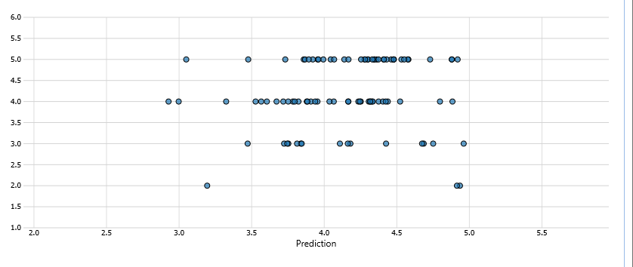
KNN continuous - MLR
Training metrics using 80/20:
Validation metrics 80/20:
Metric | Value
SSE | 0
MSE | 0
RMSE | 0
MAD | 0
R2 | 1
Metric | Value
SSE | 74.55307
MSE | 0.801646
RMSE | 0.895347
MAD | 0.705963
R2 | -0.19254
Search log 80/20:
Scatter plot 80/20:
K | RMSE
10 | 0.892194
9 | 0.895347
8 | 0.905921
7 | 0.92276
6 | 0.95135
5 | 0.977799
4 | 1.013148
3 | 1.043463
2 | 1.125286
1 | 1.299297
Notes:
Therefor based on the Best subset model a set of values that are the most significant based on p-value were selected and data was partition again with 0.3 and 0.2 cutoffs which yielded better results with 70/30 partition and K = 9 having R2 = -0.08 and RMSE = 1.11 indicating this model was able to slightly describe the data better however with a significant error rate.
Again, data was partitioned with a 0.2 cutoff with K = 9 slightly improving the R2 (-0.27) however the error rate increased to RMSE = 1.15.
Finally the variables from MLR were selected which were partitioned twice using cutoff values of 0.2 and 0.3, this model had significant improvement in RMSE= 0.895 however the training data still suggested overfitting while the R2 decreased to -0.19

Slide 15
350
North America
45
Oceania
Count of User Continent
130
35
8
10
Europe
Asia
South America
Africa
User Continent
Data Cleaning and Pre-Processing

Slide 16
250
Couples
120
Families
85
Friends
75
Business
25
Count of Traveler Types
Couples
Solo
Traveler Types
Data Cleaning and Pre-Processing

Slide 17
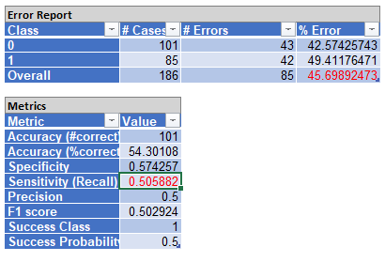
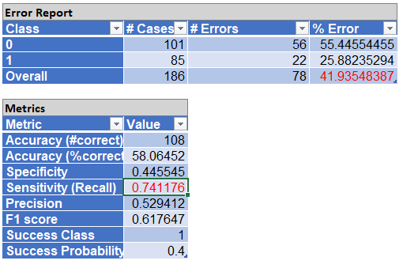
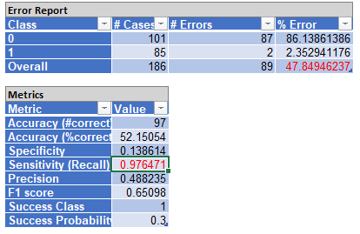
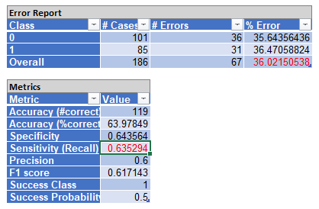
Logistic Regression 60/40
Forward
Backward
Forward
Backward
Forward
Notes:
In this dataset, when we perform logistic regression we did two different models. After we observed the default partition with both forward and backward selection, they didn't provide a better result. Our goal with logistic regression is to increase its sensitivity percentage to almost 1. At the same time we need to observe what cut off rate will decrease specificity and increase sensitivity. To get the best result, our data need to have the lowest error rate and highest sensitivity and relatively low specificity.
First, we did default partition, forward model selection and default cut off rate (0.5) by using the data mining tool. The result was shown as error rate 45, its sensitivity is about 0.5. In our dataset, our goal is to increase sensitivity, thus we need to lower the cut off rate to 0.4. Error rate decreased to 41 and sensitivity increased by 0.2. It is a good sign to see an increase in sensitivity. We try to be more aggressive and make our cut off to 0.3, both error rate and sensitivity increased. It is not a good result at this point.
The forward selection didn't turn out well, our team tried the second selection backward. Unlike forward selection gave us 6 subset to pick from, backward selection gave us 15 options. After comparing with Mallows’ CP, we end up choosing subset 2. Similar to forward selection, the default cut off rate showed the lowest error rate at 36 and sensitivity at 0.63. Our group aimed to bring up the sensitivity, so we modified the cut off to 0.4; sensitivity did increase, at the same time error rate increased as well.

Slide 18
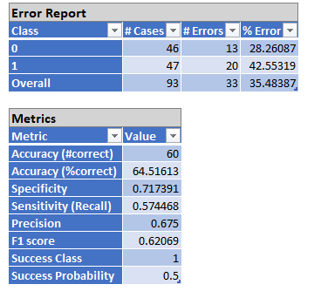
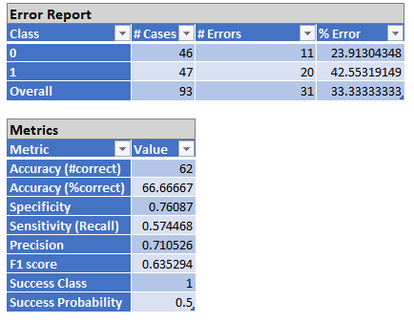
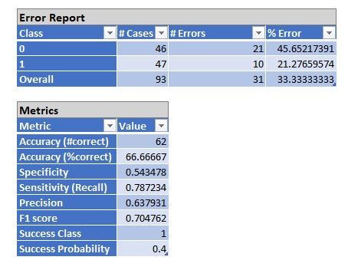
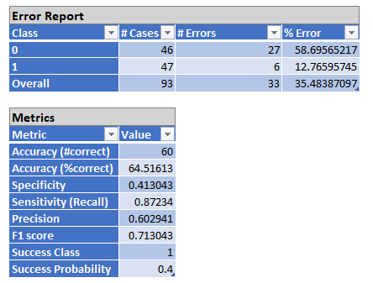
Logistic Regression 80/20
Backward
Forward
Forward
Backward
Notes:
After looking at the default partition, our group does no't think the 60 and 40 model will provide a good result; thus we customized the partition into 80 and 20 modeling. Similar to the default partition, customized partitions will perform both forward and backward selection, and compare which one will bring better results. With 80 and 20 partitions, let’s focus on forward selection first, since that is the most common method. During the process, forward selection gave 5 subsets to this dataset, we used subset 5 to run further logistic regression after evaluating Mallows’ CP. The result of forward selection with default cut off doesn’t have a good outcome, its error rate at 33 and its sensitivity is at 0.574. Due to the fact that we want high specificity we define 0.574 specificity as low and we took a lower cut off rate. While we observed 0.4 cut off, we found both its error rate and sensitivity increase. So far, sensitivity reached highest at forward selection 0.4 cut off.
Moreover, we still want to look at backward selection within partition 80 and 20. While performing backward selection, the model gave 15 subsets to evaluate. We looked at Mallows' CP and found subset 2 as our partition goal. Like the other three, backward selection was run at default cut off to produce the number for comparison. Both 60/40 and 80/20 partitions share similar results when cut off rate on default 0.5. At this model, the error rate is around 35, and sensitivity at 0.57. When the model cut off at 0.4, the error rate decreased to 33 and increased with its sensitivity to 0.78.
Compared with all results with both partitions and all types of cut off rate, we did observations on all results and found 80/20 partitions, backward selection and cut off rate at 0.4 give the best result among them. After observation with this dataset, our team concluded several reasons why this dataset is underperformance. This could be due to how simple the model is or features input are too simple on this dataset.

Slide 19
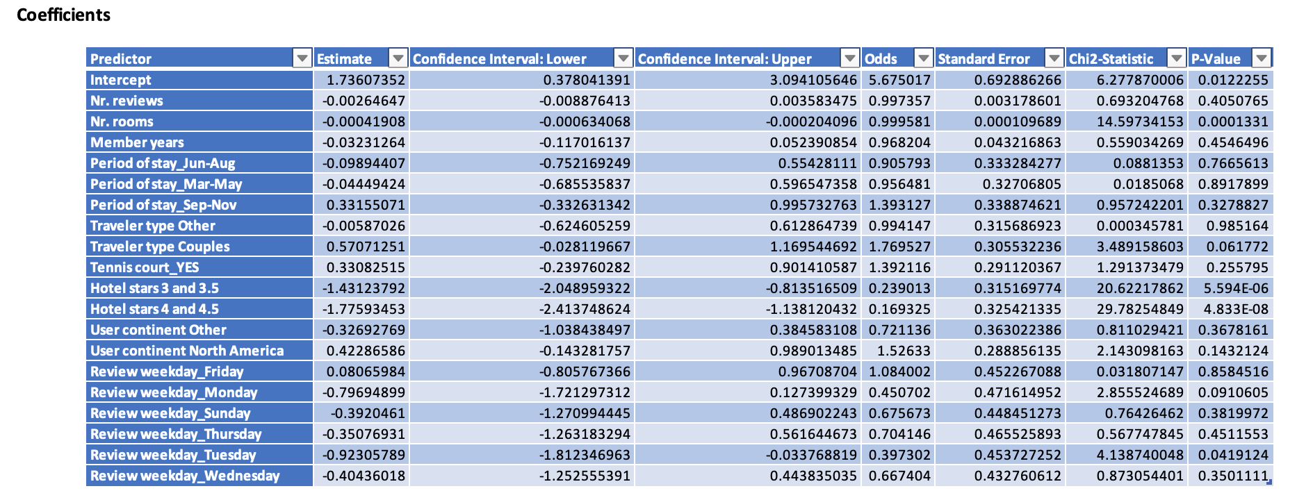
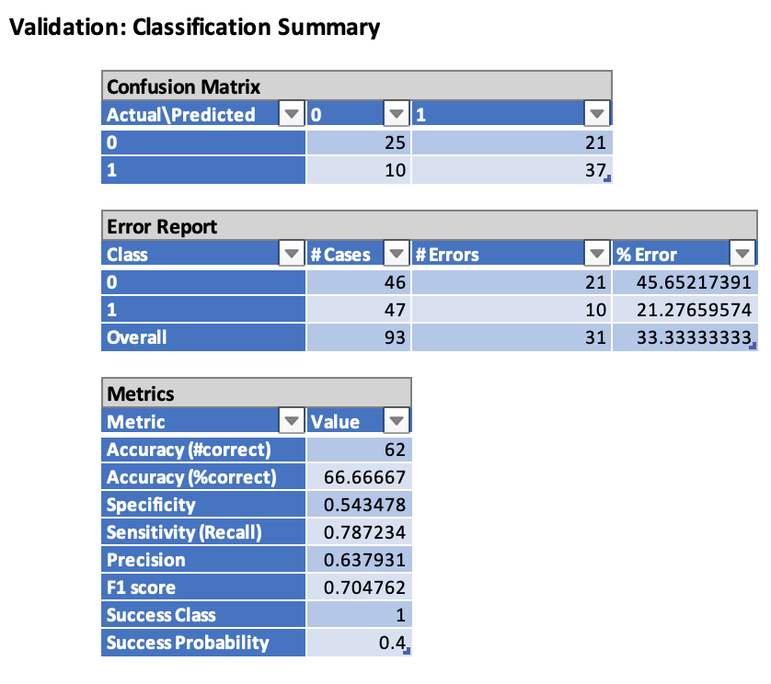

Slide 20
Multiple Linear Regression Models:
Backward Elimination
Forward Selection
Boosting
MLR
Sequential Replacement
Stepwise Selection
Ensemble
Random Forest Tree
Notes:
For the multiple linear regression models the feature selections and the methods on hand that we used where backwards elimination forward selection sequential replacement stepwise selection and ensemble in ensemble we used boosting and random forestry which are more typically used in machine learning models. For the majority of the data set when we applied the methods towards our data the results were typically characteristic of a model that we would say is underspecified or mis specified, this misspecification of our model essentially could mean that we lack enough data to create a strong enough predictive model. Whether we used any of the seven methods at our disposal The results were rather similar. When checking the training data and the validation data for each model the pattern that we noticed was that the R-squared and adjusted R-squared including the RMSE where characteristic of a model that is poorly optimize to its parameters. This in essence means that we don't have enough data to create a model that would give a strong enough relationship between our inputs our desired target variable which was score there are several factors for why our model might be mis specified which we will go into later in the slides. In order to exhaust all our options with the limited data set that we used more complex techniques and we decided to go towards boosting and random forest tree. We wanted to minimize the bias variance and try to prevent overfitting of the training data. these two models use specific algorithms that help parse and manipulate our data set in such a way that is more efficient in preventing overfitting of the training data and emphasizing the validation data in terms of the parameters that we use, however unfortunately these two methods performed worse in the validation data resulting in an R square of negative. A R-squared of negative essentially means that if we were to draw a horizontal line through our model or graph then it would be better than using the method prescribed.

Slide 21
Best Subset Model
Validation Prediction Summary
Regression Summary
Training Prediction Summary
Coefficents/Signficance
Notes:
As a primary example when looking at the best subset model we can gather from our analysis when we look at the RMSE and the R-squared value that our model poorly fits and poorly predicts the true value of our data. With an error rate of 97% and an R-squared value of nine percent we are looking at a model that misclassifies 97% of the time the predicted value versus the true score and has a correlation of 9% which is rather low. However, one thing to be noted is that in model such as this a correlation of 13% and above is common so we should be hesitant and dive deeper into our data set and model in order to tease out any relationships manually. One interesting pattern that we notice throughout each method that is run is that our training data tends to do better than our validation data even though we've gone with an 8020 split we've decided that 80% of our data should be focused on training our actual model while 20% should be used for testing and validating. The assumption was that if using an 8020 model we would compensate for the lack of data by training our models with the majority of our data set however this is proven wrong as you can see. Furthermore, when we look at our regression summary, we can see that our R-squared an adjusted R-squared ranges from 8 to 11% with an error of .97 at once again further ingraining that this in fact is a bad model regardless of which method we choose or how we change our parameters and inputs. Further looking at the coefficients and significance table we can tease out that the number of rooms the type of travelers the review weekday for Tuesday and Wednesday seem to be more important factors due to their P value being lower than our Alpha therefore we cannot reject our null hypothesis that they are not important inputs yeah.

Slide 22
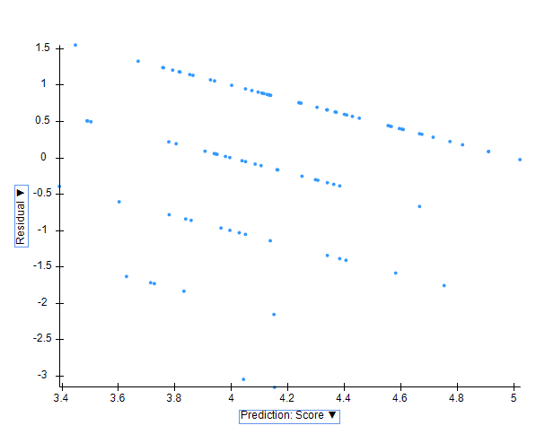
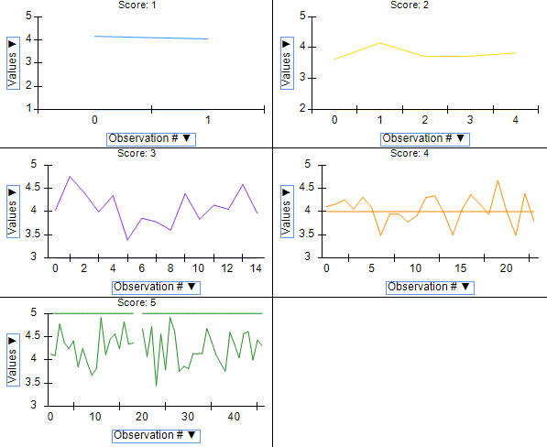
Best Subset Model
Validation: Prediction vs. Residual
Validation: Prediction Variance
Notes:
Looking at a visual representation of our best subset model when we look at the validation visualization, we see that we've plotted prediction versus residual and we can see that there is an odd trend of it having a downward sloping linear shift. The first thing we can assume is that there's very little correlation between our data set seeing as our predicted score and our residual have a high amount of variance and by variance, we mean that when we look at the true score and we compare it to the predicted score the margin of error is quite high. This margin of error is further cemented by looking at our R-squared and RRMSE values and seeing that in fact our models are poorly optimized for prediction. they are poorly optimized in the sense that our inputs are either too few, not strong enough, or irrelevant to predicting our target variable. Furthermore, when we look at the visualization of our variance on the right hand side, we can see that our target variable which is score ranging from one to five; we notice that there is a high indication of variance looking at score one , score 2, score 3, score 4 and, score 5. The values that are plotted show a high amount of variability which we can notice by how the graph zigzags up and down showing instability in our prediction and our model, ideally, we would want a model that predicts fairly close towards our score with very little deviation but as you can see this is not true for our data set and our methods used

Slide 23
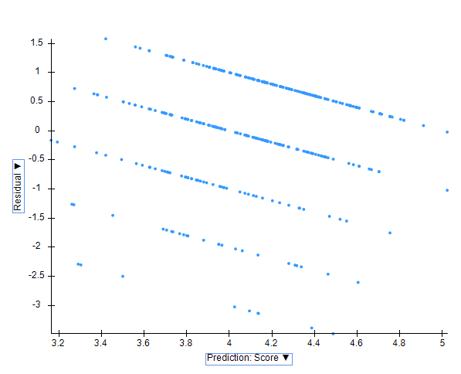
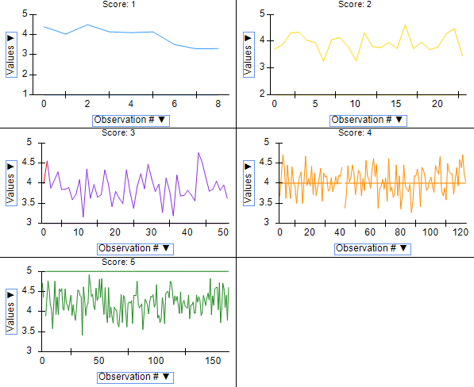
Best Subset Model
Training: Prediction vs. Residual
Training: Prediction Variance
Notes:
Looking at our training visualization for best subset model when we look at the variance on the right hand side we can see that when comparing the score to our predictions although they are still very inaccurate, we can make the visual statement that the model does fit our training data much better than it did our validation data on the basis that for example when we look at score 4 although there is high variance in the amount of what is predicted versus what the actual score is it's still predicts more accurately on the training data then our validation. This again suggests that our models overfit our training data and that we should aim to correct for that however due to the limited size of our data set or the irrelevance of our parameters it seems that any model that we may run or any method that we may choose will not yield positive results because bad data in will result in a bad model outcome.

Slide 24
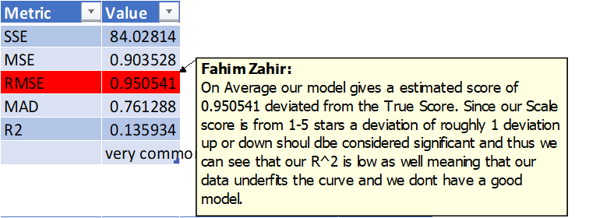
Forward Selection Model
Subset 4
Notes:
Continuing to showing a second model I've decided to show the forward selection model because it is the one method that is produced a model with an R-squared of 13% and although the RMS E is still high, this is the singular method that has produced a correlation percentage which is rather acceptable. On average our model gives us a estimated score of 0.95 deviation from the true score. Since our scale score is from one to five stars a deviation of roughly 1 plus or minus should be considered high however the redeeming factor of this method is that our model has a decent R-squared value which means that the parameters chosen by this method is more appropriate Anne represents the data and input more accurately and strongly in regard to our target variable. We can see that the model decides to use the predictors of number of rooms , the traveler type couples, and hotel stars three and four. Based on this model output and our predictor screening it's safe to assume that these predictors our decent indicators of strong inputs that correlate to our target variable. Furthermore, we can see that when we observe the P values, they are actually significant Ann this further cements that although the model has a high error rate in predicting the true score the R-squared value makes up for some of the inadequacy‘s of our prediction model.

Slide 25

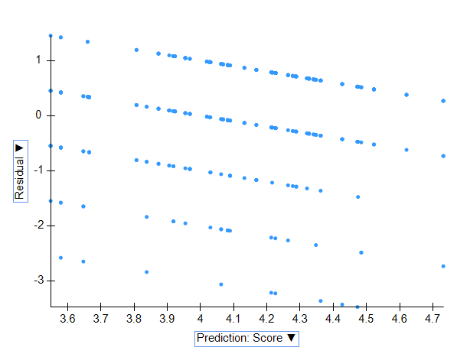
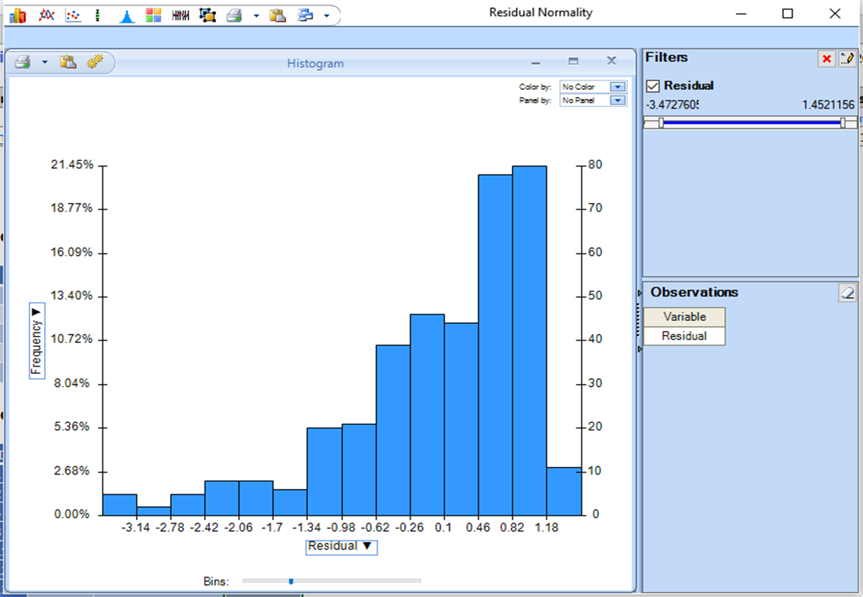



Forward Selection Model Training Data Assumptions
Our training data for our models show that they violate the 4 assumptions of MLR:
Normality (Red Line)
Linearity (Green Rectangle)
Homoscedastic (Purple)
Independence (Red Box)
Notes:
Looking at our forward selection model and examining the trade training data we want to check if the four assumptions of MLR are true or false. The four assumptions being normality linearity homoscedasticity and independence. As we can see on the graph to the left that based on our shapes we can see that indeed our model and in our training, data violates the four assumptions Ann follows neither we could maybe make a case for linearity but it is quite hard to justify that our training data follows. any of the assumptions. When we look to the graph on the right we can also see that how are residual data fares in terms of variability we can see that there is a left tail skew to our residual meaning that the values go beyond the mean of our data an possibly skewing our prediction by overestimating

Slide 26
Talking Points on Other Methods
For Step-Wise, Sequential, and Backwards methods there was no noticeable change in predictive power.
The models performed worse than Forward Selection Subset 4 or Best Subsets.
Since the models performed worse or comparable, we have chosen not to include them in the slides.
An 80/20 split was used for every model and the feature selections were set to the max allowable by Xlminer.
Hyper-parametrization was utilized, and we tried to square or raise to the 4th power some features in order to tease out a greater relationship, but it made no difference.
For Boosting and Random Forest there was not enough data for the models to properly learn so as expected they overfit the training data but did noticeably worse on the validation. It resulted in a negative R^2 which just means that its performance is no better than random.
Stepwise
Sequential
Backwards Elimination
Boosting/ Random Forest
Notes:
Having discussed the best subset model and the forward selection model we are aware that there are several methods left at our disposal. These methods being the stepwise , sequential , backwards elimination, boosting and random forests. We have decided to not visually include these methods in our PowerPoint because the results that they output are either comparable to the models discussed above or in fact worse and because they are so similar we have decided to show the best performing models in MLR. An 80/20 split was used for all our methods and the maximum allowable feature selections was selected in Excel miner. However, to make sure that we have used up all our options and have done an exhaustive analysis of our data we decided to tweak our input variables and predictors. Hyper parametrization was utilized, and we tried to square or even raise the predictors to the 4th power in order to try to highlight a greater relationship in our models but unfortunately it made no difference. A few methods outside the scope of this class such as boosting and random forests was also used to try an utilizes advanced methods since we had a small data set which could not be expanded upon due to time limitations, we used these two ensemble methods in order to correct for any overfitting of the training data because that is the purpose of these two methods. However even with these two methods utilized we noticed no change in our model and in fact our validation model performed worse than when we used the less complicated methods but one thing to know is that our training data did rather well and we had a high accuracy however because we're looking for a predictive model doing well on the training data is irrelevant an in fact is something we're not looking for .

Slide 27
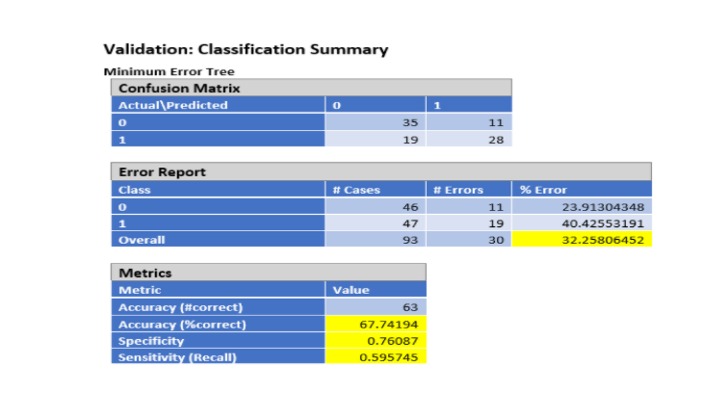
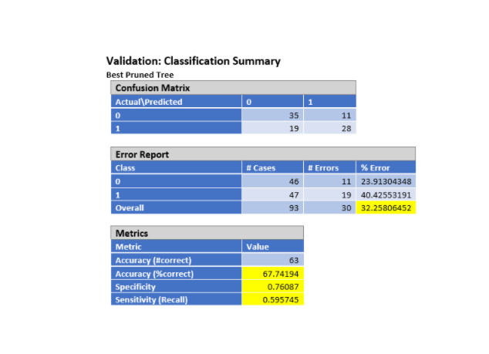
CART Classification
Notes:
We performed both regression and classification models to compare results and identify the most successful model. The classification model produced more accurate results. Using the different cutoffs of .3, .4, and .5 to partition the data we found the .5 cutoff was the best fit for our model. We pruned the tree using both the minimum error and best pruned trees (both producing the same results). The sensitivity was 60% for correctly identifying class 1 and the specificity was 76% in correctly identifying class 0, while the error rate was unusually high at 32.26%.

Slide 28
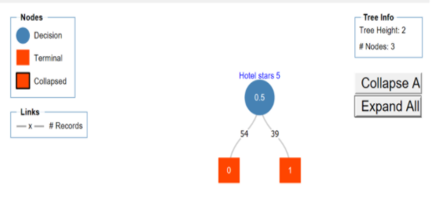
CART Classification
Notes:
The classification tree has a height of only two and contains only three nodes to classify the class 1 and class 0 variables. Both the best pruned tree and the minimum error tree produced the same results.

Slide 29
Which is best?
Continuous: Lowest RMSE
MLR (forward selection model): RMSE = 0.95
KNN (Continuous): RMSE = 1.16
Categorical: Lowest Error Rate
Logistic Regression (forward): ER = 33.33%
KNN (categorical): ER = 39.65%
CART: ER = 32%
Notes:
No specific best model picked, because the outcome is not precisely predicted.
However, we still picked out the two models that has lowest RMSE and Error Rate.
In the situation of Continuous: the forward select model of MLR presents the lowest RMSE among all models.
In the situation of Categorical: the CART presents the lowest Error Rate.
Therefore, the forward select model of MLR and CART will be the two model which preform the best in each scneriao.
Thanks for our group member who contributed their work to the model in the previous slides, and ill be talking about the model selection, result, and conclusion slides
Through our experiment, we wasn’t able to predict a good result from doing only categorical model; thus,we divide the data in to two scenarios (continuous & categorical).
Recall the results from our models, none of the model predicts the precise outcome for dependent variable. Thus, as for our result, we do not have the best model. However, we have chosen the model that contains the lowest RMSE and Error rate. As for continuous, we discovered lowest RMSE when we are using the forward selection model in MLR, and lowest Error Rate when we employed the CART for categorical. Therefore, we pick CART and forward selection in MLR as the better performance model.

Slide 30
Results
Reasons of resulting the bad outcome
Data set is insufficient
Size of training data is too small
No obvious relationship between variables
Weak correlation and patterns to support the dependent variable.
The model is suffered from accuracy and precision issues due to the misspecification
Improper data
High level of noise
Notes:
As mentioned in the introduction, we can also compare our results to the three papers referenced earlier.
In the paper from Iowa State University, they found that the independent variable of value showed a statistically significant impact on the dependent variable. They also found that the rating of the room had a large impact on dependent variable. In our dataset, we were not able to conclude that our variables has a significant impact on the score.
In the paper from the Journal of Travel Research, their results indicate that hotel attributes, including the quality of rooms, Internet provision and building show the highest impact on hotel performance/score, and that positive comments have the highest impact on customer demand.
In the paper from the Cornell Hospitality Quarterly, the results show that hotel attributes and the personal characteristics of visitors most powerfully impact customer satisfaction.
We found that these papers had more successful results due to their better data. Overall, their data had better independent variables, which allowed them to find success in their analysis. Our data lacked the necessary volume to find a predictor, whereas theirs was large with less noise.
Results:
Despite attempts to give feature selection variables higher importance or adding more features the model shows no significant change. In fact, when attempting to use more complex models we notice that the training data fits better but the validation data performs drastically worse. This may be due to the advanced models “regularizing” and in general the R^2 value produced is negative which implies that the model predicts worse than if we were to simply draw a horizontal line across the data.
Attempting to fix for noise we tried to further process and clean the data of any columns that provided no significant impact but no difference was shown.
Final result: model is misspecified
After the we conduct all models on the dataset through our experiment, the prediction performance is far away from our expectation. As for the result, our error rate and RMSE is poorly performed. As we increase the partition portion on the training data, the model has lower Error Rate. Thus, we think one of the reasons that contribute to the bad result is insufficiency of the data sets. And when we using more complex model, the training data fits better; however, the validation data still preformed poorly. Thus, we think another reason is that the data set does not have sufficient informative variables to express the target variables.
The model is miss specified. Recall the research paper we have found from Iowa state university, they used similar dataset and they discovered a strong relationship between independent variables and target variable. And their research shows, that strong relationship between independent variables and target variable, will lower the error rate. Thus, we used result from this paper to compare with our outcomes and to support our conjecture from our data, which independent variables are insufficient informative and model is miss specified.

Slide 31
Conclusion
Data Challenges
Interpolation Issues
Analysis
We faced quite a few data challenges:
Too few data
Bad Data
Unreliable outcomes
Irrelevant Predictors
Solutions
Due to the unique challenges of the dataset, we faced issues on rejecting or accepting our Hypothesis. Since the data was filled with weak predictors, we could not make a best “guess” with confidence
Despite using all the data mining methods available—Results were poor.
Models all misclassify
Models have a high RMSE
Suggests that predictive capabilities are low, and predictors are weak
Next Steps
We learned that more complex models may yield better results.
Cleaning more rigorously did improve results slightly.
Using more data would be the next logical step (Outside of scope for Project)
Scrape larger dataset
Tuning Parameters
Use more applicable model learning.
Use of Evolutionary or gradient based optimizations.
Notes:
What we have learned so far?
How to deploy the model with different situation
How to interpret the model and discover the fact
How to improve the data set accuracy?
Replace the original variables with other attributes which are highly correlated with the dependent variables.
Adding more feature attributes to the data sets
Throughout our experiments, we have faced few challenges and few obstacles with interoperation. Such as, we need to make interpretation from bad data and from unreliable out comes, also we have to decide whether we need to reject or accept out hypothesis.
However, we still found our way to make the final analysis and solved problem with solutions for this data set .
For example we have come up with the solution of cleaning date more meticulously and we used square method to improve the accuracy.
The next step would be fix the data with informative independent variables that related to the target variables
Throughout the progress, we have get familiar with the data mining technics and concepts. And we believe such experience is crucial to our skills that can help us in the future work field.

Slide 32
References & Appendix
Markham-Bagnra, Suzanne Dawn, "An examination of online ratings on hotel performance
indicators: An analysis of the Boston hotel market" (2016). Graduate Theses and Dissertations. 15971. https://lib.dr.iastate.edu/cgi/viewcontent.cgi?article=5001&context=etd
Phillips, P., Barnes, S., Zigan, K., & Schegg, R. (2016). Understanding The Impact of
Online Reviews On Hotel Performance: An Empirical Analysis. Retrieved from https://internet.psych.wisc.edu/wp-content/uploads/532-Master/532-UnitPa
Radojević, Tijana & Stanisic, Nemanja & Stanić, Nenad. (2017). Inside the Rating Scores: A
Multilevel Analysis of the Factors Influencing Customer Satisfaction in the Hotel Industry. Cornell Hospitality Quarterly. 58. 134-164. https://www.researchgate.net/publication/312164283_Inside_the_Rating_Scores_A_Multilevel_Analysis_of_the_Factors_Influencing_Customer_Satisfaction_in_the_Hotel_Industry

